Slide 1
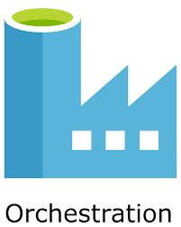

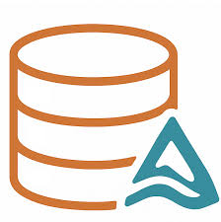

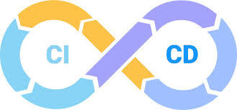
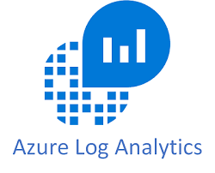
ETL and ML Automation on Azure
An End-to-End MLOps Project for U.S. House Price Prediction

Slide 2
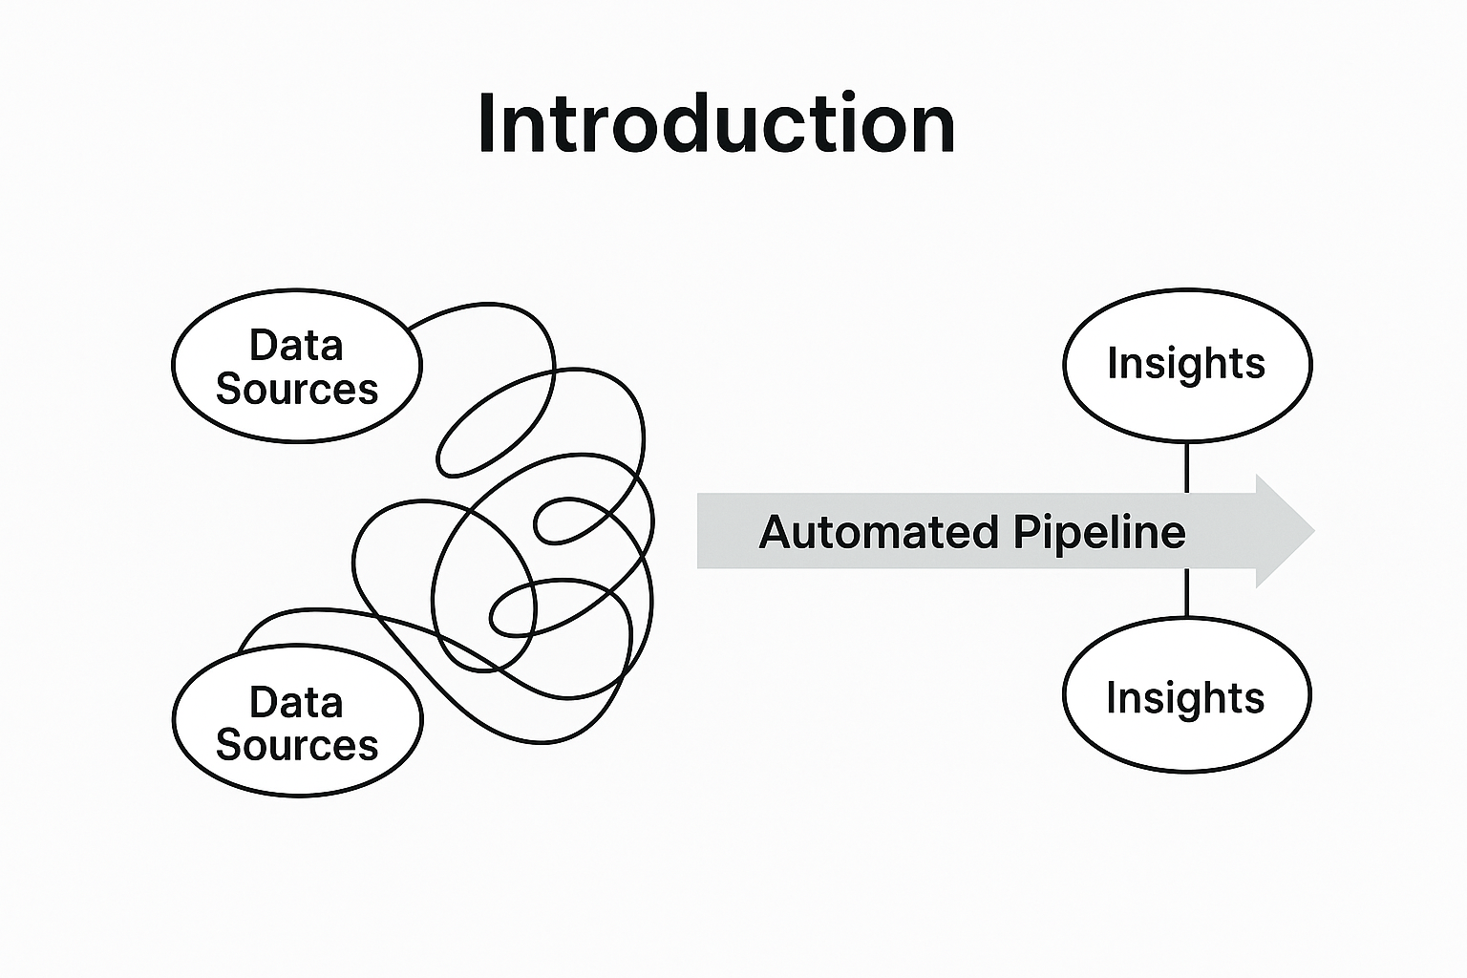
Introduction
The Challenge of Traditional Analytics: Manual data processing and fragmented ML workflows are inefficient, error-prone, and difficult to scale. This fragmentation leads to:
Operational delays and inconsistent data quality.
Significant challenges in governance and reproducibility across environments.
Our Solution: A Unified, Automated Ecosystem: We built a fully automated, cloud-native ETL and machine learning pipeline on Microsoft Azure to address these challenges head-on.

Slide 3
Project Goals
📍 Predict House Prices: Develop an accurate regression model to predict U.S. house sale prices.
🤖 Automate the Entire Pipeline: Create an end-to-end automated workflow from data ingestion to model execution.
📚 Ensure Data Quality: Implement the Medallion Architecture (Bronze→Silver→Gold) for progressive data refinement and quality control.
⚙️ Establish a Reproducible Solution: Use Azure DevOps for CI/CD to enable consistent, automated, and version-controlled deployments.
📊 Provide Actionable Insights: Enable comprehensive monitoring of pipeline health, performance, and failures using Azure Log Analytics.

Slide 4
The Business Impact
💰 Reduces Operational Overhead: Eliminates manual, time-consuming data processing tasks, freeing up data teams for higher-value work.
⏱️ Accelerates Time-to-Insight: Automated workflows deliver analytics-ready data and ML predictions faster, enabling more agile decision-making.
🔍 Increases Trust in Data: The Medallion Architecture, combined with Delta Lake and DLT, ensures data is reliable, validated, and of high quality.
📦 Enhances Scalability & Maintainability: The cloud-native, modular design allows the system to scale easily and simplifies maintenance and troubleshooting.

Slide 5
Success Criteria
✅ Fully Automated Ingestion: Data is automatically synchronized from a GitHub source to the data lake on a schedule.
✅ Enforced Data Quality: Invalid records are automatically filtered or dropped using Delta Live Tables (DLT) expectations.
✅ High-Performance ML Model: A Random Forest Regressor, trained on log-transformed data, effectively predicts house prices.
✅ Reproducible Deployments: All notebooks are version-controlled in Git and deployed automatically via an Azure DevOps CI/CD pipeline.
✅ Comprehensive Observability: All pipeline and job logs are centralized in Azure Log Analytics for real-time monitoring and querying.

Slide 6
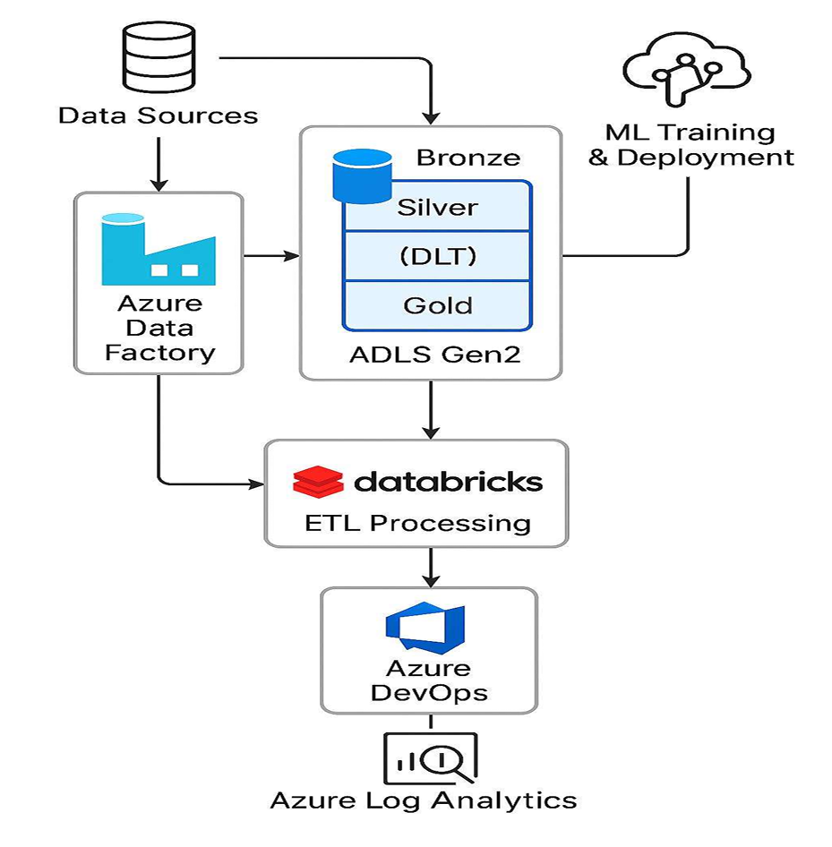
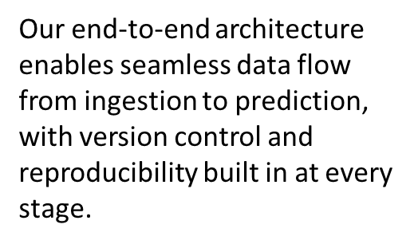
Solution Architecture

Slide 7
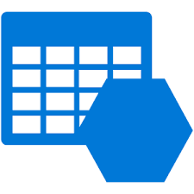
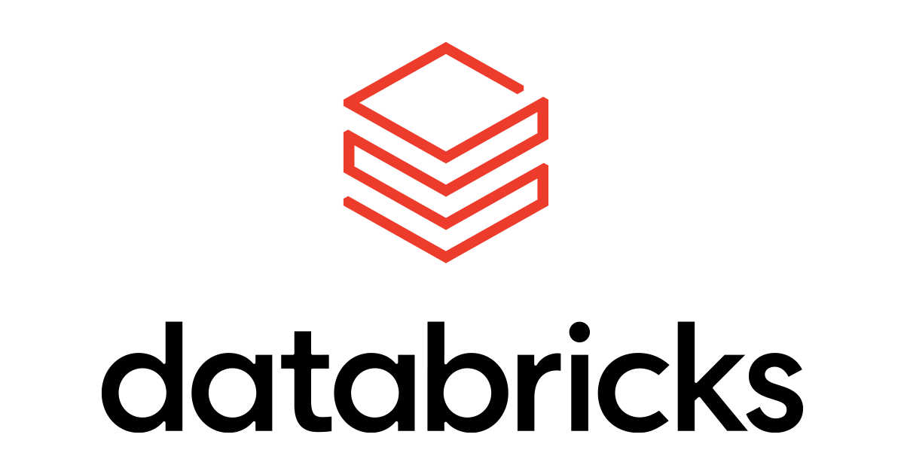
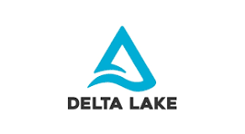
Tech Stack: Data Storage & Processing
Azure Data Lake Storage Gen2: Serves as the centralized, scalable data repository, structured into Bronze, Silver, and Gold zones for our Medallion Architecture.
Azure Databricks: The core compute platform for executing all data transformation and machine learning workflows using scalable job clusters and Apache Spark.
Delta Lake: An open-source storage layer that brings ACID transactions, schema enforcement, and time travel capabilities to our data lake, ensuring reliability and robustness.

Slide 8
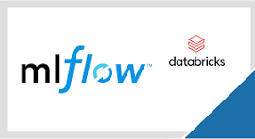
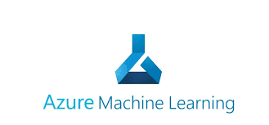
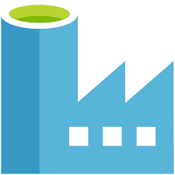
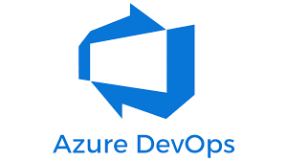
Tech Stack: MLOps & Orchestration
Azure Data Factory (ADF): The central orchestrator that triggers ingestion pipelines and coordinates the execution of downstream Databricks jobs.
MLflow (within Databricks): Used for managing the ML lifecycle, including tracking experiments, logging parameters, and saving model artifacts.
Azure Machine Learning: Integrated for advanced lifecycle management and deployment of models as REST APIs or batch inference pipelines.
Azure DevOps & Git: Provides version control for all notebooks and automates the CI/CD pipeline for deploying code changes to the Databricks workspace.

Slide 9
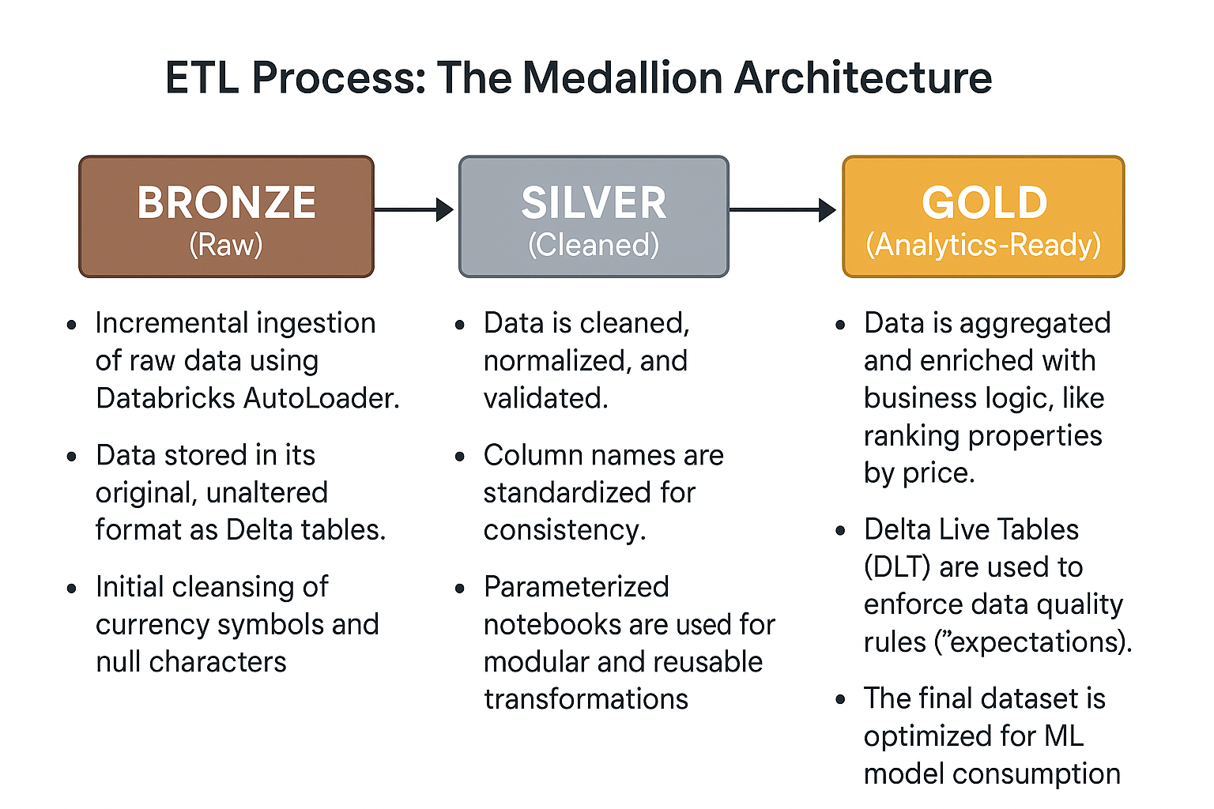
ETL Process: The Medallion Architecture

Slide 10
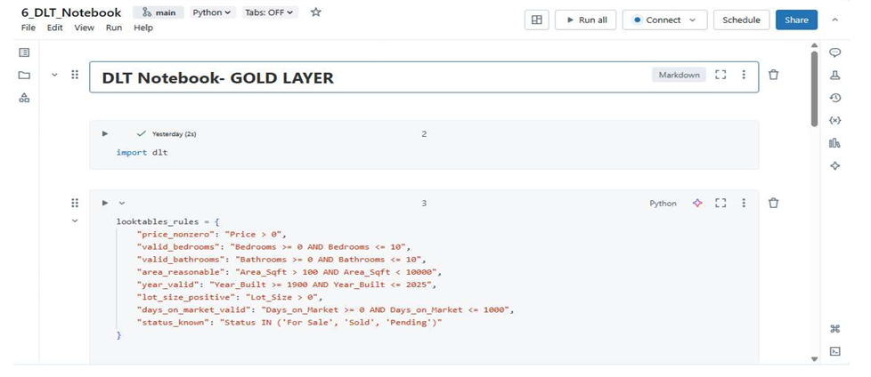
Implementation Detail: Data Quality with DLT
We use Delta Live Tables to create a declarative, self-validating pipeline for our Gold layer.
Data quality is enforced using @dlt.expect_all_or_drop, which automatically removes any records that fail our predefined validation rules.
This ensures that our ML models are only trained on high-quality, trustworthy data.

Slide 11
Implementation Detail: Model Training
Models Trained:
Random Forest Regressor: A more powerful model that handles complex relationships in the data. To manage skew, the target variable (
Price) was log-transformed before training.
Isolation Forest: An unsupervised model used to detect anomalous property records.
Linear Regression: A baseline model for initial predictions.
Feature Engineering: A VectorAssembler was used to combine all input features into a single vector column for model consumption.
Model Storage: All trained models are saved to DBFS and their predictions are written back to the Gold layer as new Delta tables

Slide 12
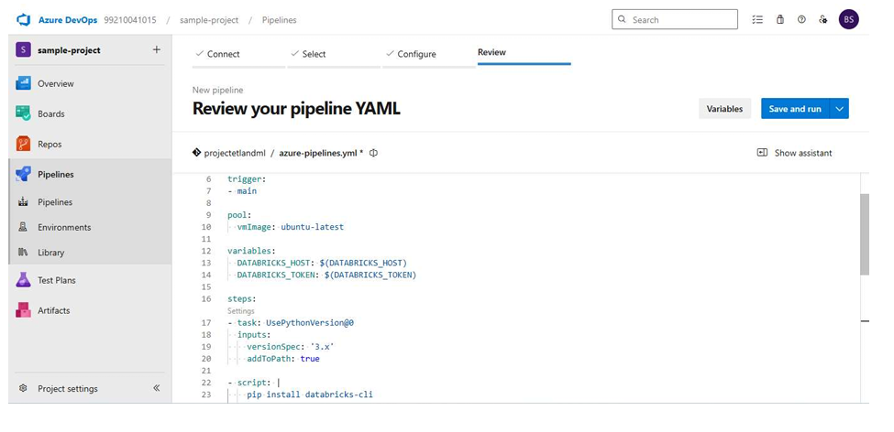
MLOps in Action: CI/CD with Azure DevOps
Version Control: All notebooks are stored and versioned in an Azure DevOps Git repository.
Automated Trigger: The CI/CD pipeline runs automatically on every commit to the main branch enabling continuous integration .

Slide 13
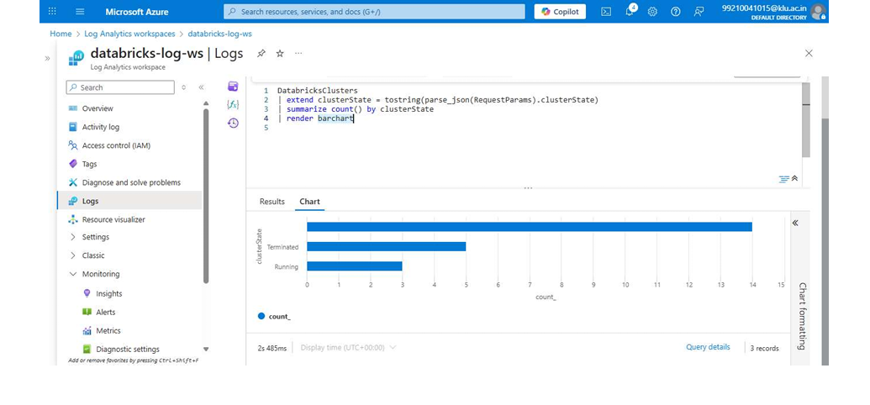
MLOps in Action: Monitoring with Log Analytics
Centralized Observability: All logs and metrics from Azure Data Factory and Databricks are sent to a central Azure Log Analytics workspace.
Powerful Querying with KQL: We use Kusto Query Language (KQL) to analyze pipeline health in real-time:
Track the status of Databricks clusters and pipeline runs.
Identify failures and performance bottlenecks.
Visualize trends using built-in charting capabilities.

Slide 14
Project Outcomes
End-to-End Automated System: Delivered a production-ready, fully automated ETL and ML system on Azure.
High-Quality, Reliable Data: The Medallion Architecture, combined with Delta Lake and DLT, guarantees trustworthy data for analytics.
Accurate Prediction Model: Developed a Random Forest model that effectively predicts house sale prices.
Robust MLOps Foundation: Implemented a complete CI/CD and monitoring solution, ensuring the pipeline is reproducible, maintainable, and observable.

